Slide 1


IDCheck by Co-op QR Code for Co-op Shared Branch
Presenter Name
Title/Company

Slide 2




A Member-Centric Focus is Mandatory: The Success Shift
82% of businesses embraced new forms of digital technology to meet their consumers’ emerging needs
47%
36%
44%
31%
are integrating security and fraud management software
Are integrating buy online pick up in-store (BOPIS)
are embracing contactless or mobile payment
are upgrading digital backend payment operations
Source: Source: PYMNTS reporting VISA Study
Notes:
And according to a VISA study, a majority of businesses that embrace new forms of digital technology meet their consumers’ emerging needs.
“The businesses that survived the global business upset that started unfolding in late winter of last year did some undeniably fast thinking that allowed them to hold on and weather the storm. They’ve made big digital shifts. According to Visa’s data, 82 percent embraced new forms of digital technology to meet their consumers’ emerging need sets. Some 47 percent are integrating security and fraud management software, 44 percent are embracing contactless or mobile payment, 36 percent are integrating buy online pick up in-store (BOPIS) and 31 percent are upgrading digital backend payment operations.”
Source: https://www.pymnts.com/smbs/2021/visa-phelan-smbs-remain-optimistic-data-shows-digital-tools-bring-new-customers

Slide 3





With an Increase in Digital Capabilities and Payments Growth, Fraud Will Continue to Evolve and Increase
Members want more digital technology capabilities with their credit union
Credit unions gain market share within 5 years through payments growth
Potential for fraud increases; members are concerned about fraud & security protection

Slide 4


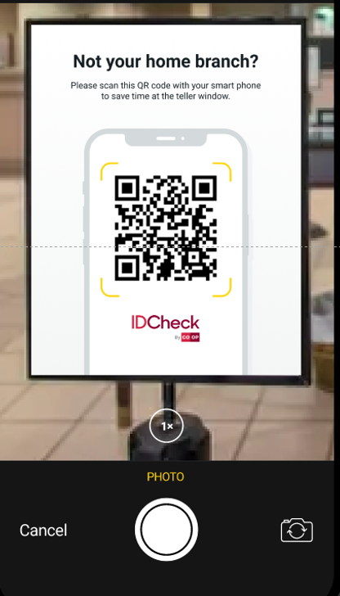

Shared Branch Fraud Mitigation
$6,300
Average per incident fraud loss in Shared Branch locations in 2023

Slide 5
Beta Insights
American Heritage Credit Union, Erie Federal Credit Union, Corry Federal Credit Union, Clearview Federal Credit Union and Omega Federal Credit Union
Beta Scenario
Beta Metrics
1K+ ID validations across 5 beta credit unions with locations in 3 states
30+ different ID types
99% first attempt validation success rate
100% of fraudulent IDs and AI generated deep fakes rejected
Member time saved with stored validation: 48%
Teller time saved: 26%

Slide 6

Invest in Digital Capabilities and Protect Members from Account Takeover Fraud
IDCheck is a source to help verify and prove a member's identity to effectively fight account takeover and identity theft in-branch fraud.
Velera does not collect any biometric information

Slide 7










Comprehensive Identification and Authentication Solutions Help Protect Vulnerable Member Moments from Account Takeover Fraud
1
Digital & web
Debit/credit transaction
Login
Identification: Verifying who you are
Driver’s license, name, member number, account number, card number, phone number, etc.
Payments
Bill pay
P2P transaction
In-person
2
Authentication: Proving who you are
OTP, QR code, biometric data, etc.
Account update
Shared branch
Phone call
Velera does not collect any biometric information

Slide 8






Unified Platform for Fraud Fighting and Prevention
Single vendor vs. managing multiple vendors
Single, standalone & unified platform to address identification & authentication needs
Increases approval rates
Decreases friction and abandonment rates
Mitigates fraud
Reduces
onboarding costs
Velera does not collect any biometric information

Slide 9

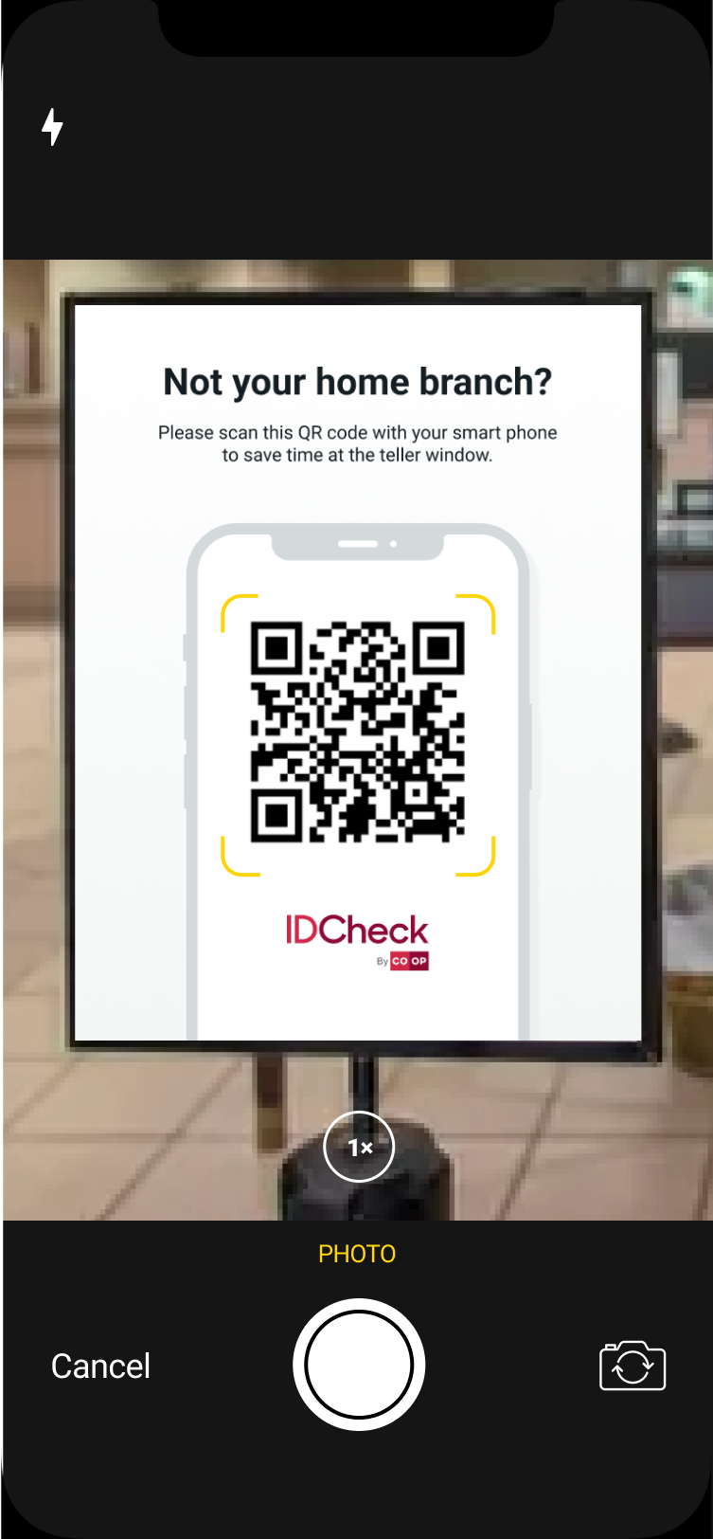
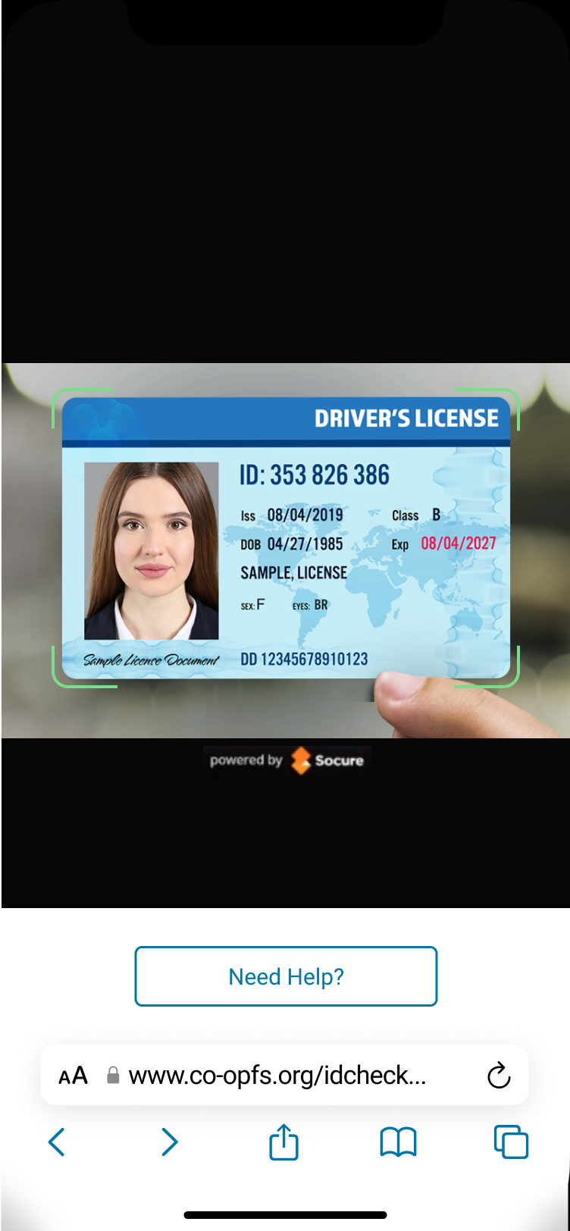
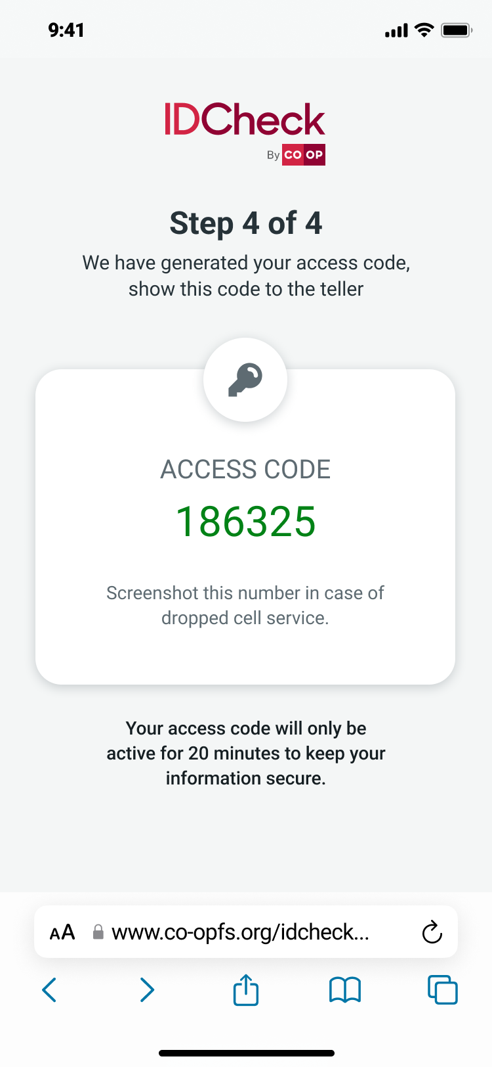
Shared Branch: QR Code Member Experience
SCAN QR CODE
UPLOAD ID
VERIFICATION
Velera does not collect any biometric information

Slide 10
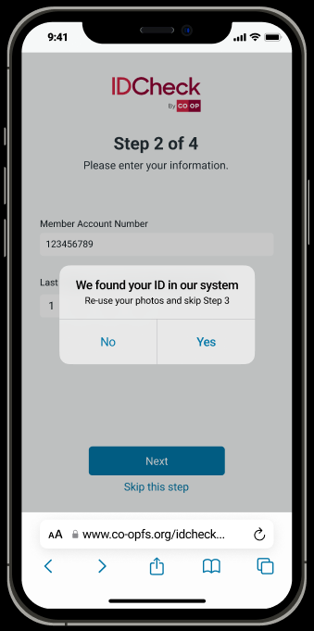
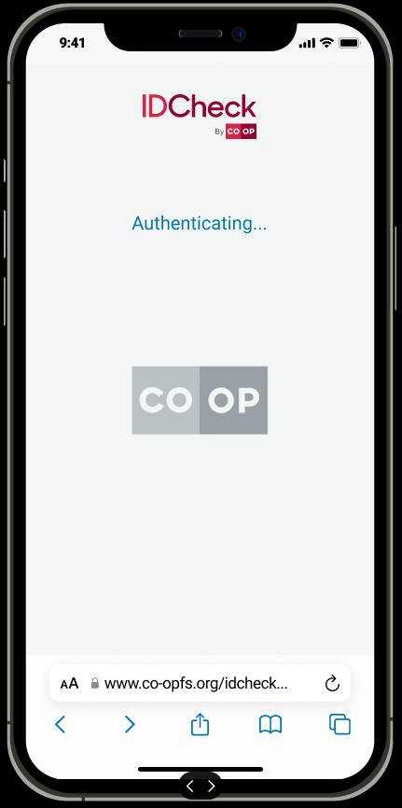
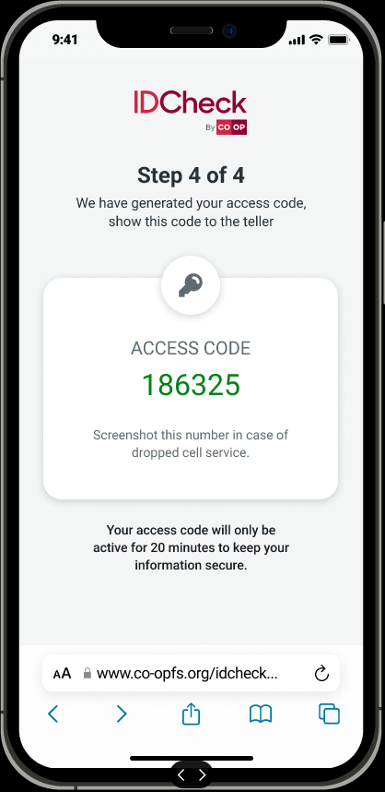
A Seamless Member Experience During Repeat Visits
RETREIVING OTP
OTP GIVEN TO MEMBER (VALID FOR 20 MIN)

Slide 11

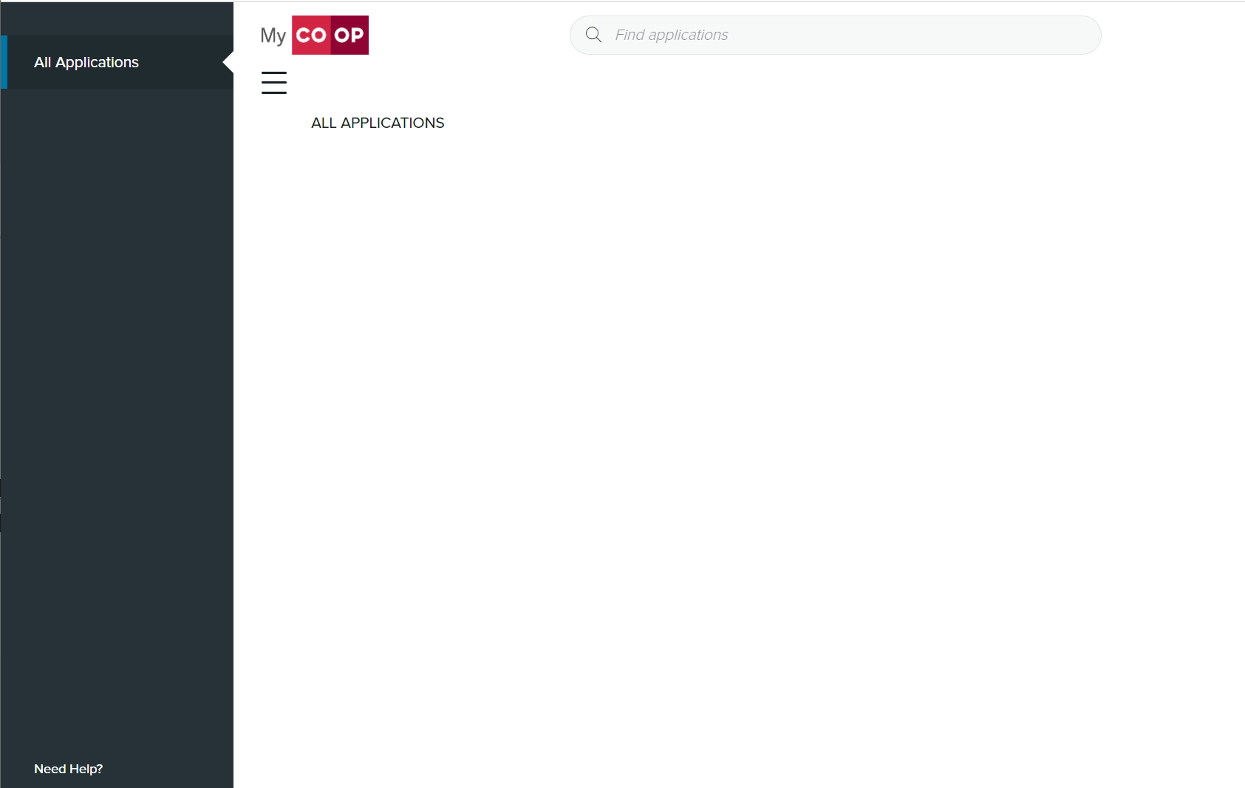

Shared Branch: Teller Workflow
My Co-op application
IDCheck

Slide 12
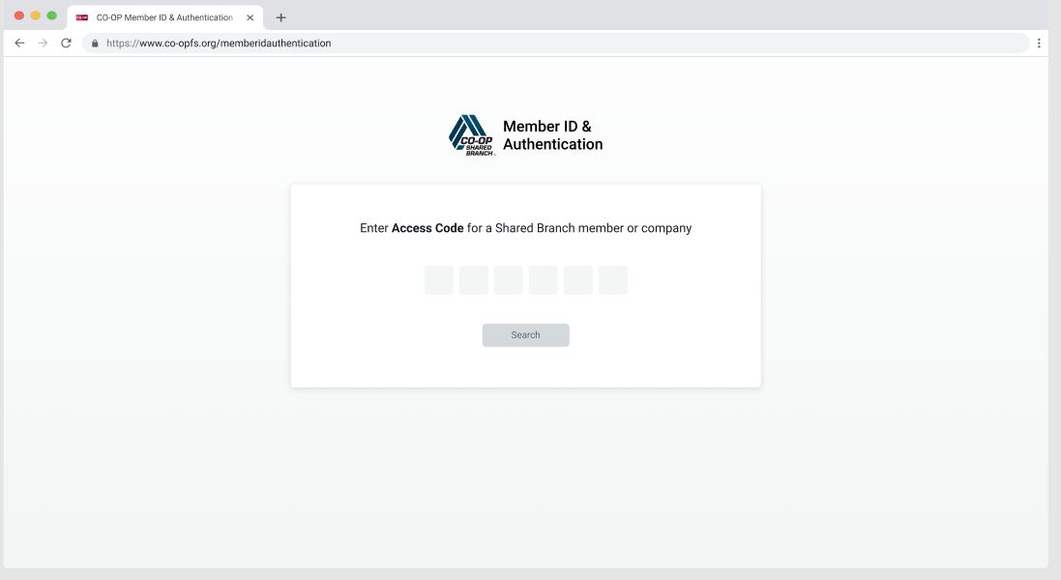

Shared Branch: Teller Workflow
Velera does not collect any biometric information

Slide 13
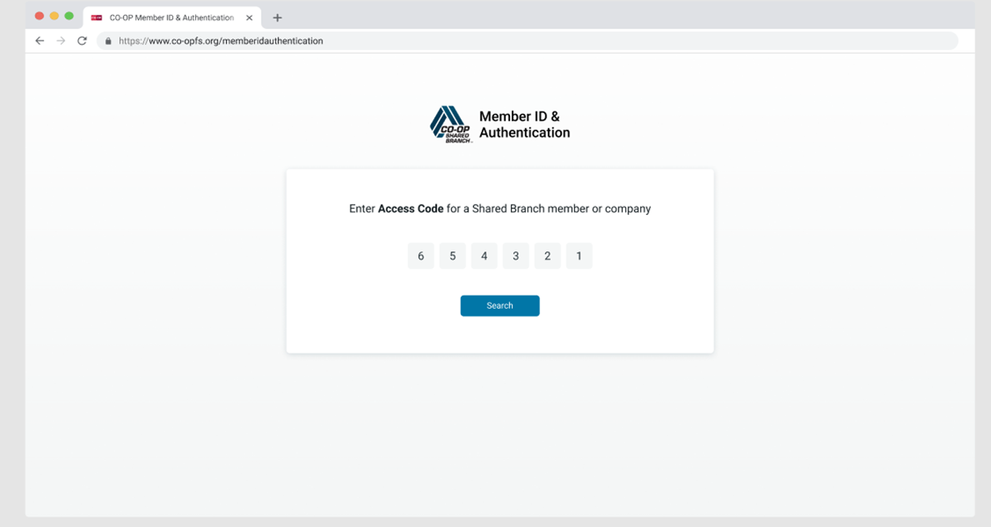
Shared Branch: Teller Workflow
Velera does not collect any biometric information

Slide 14
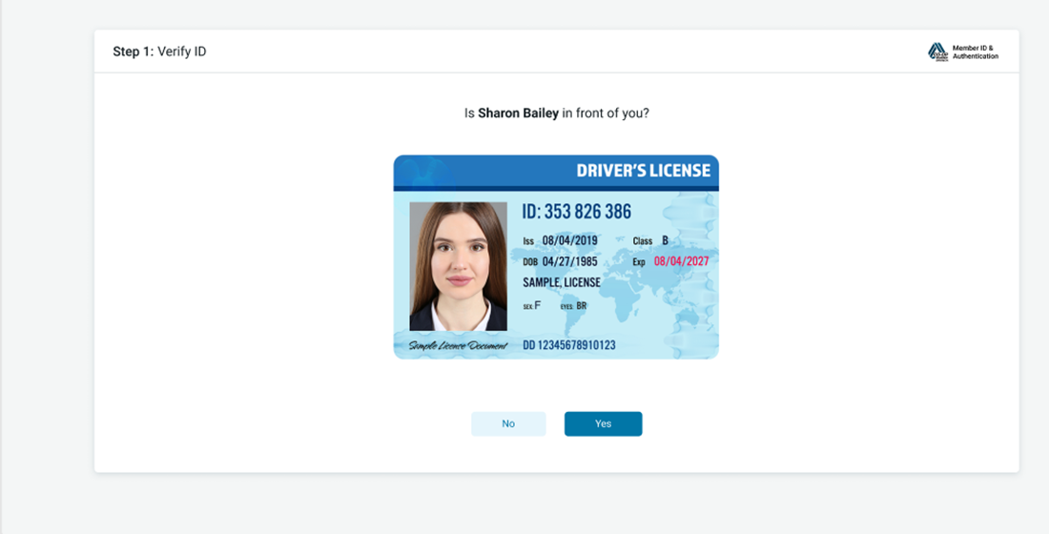
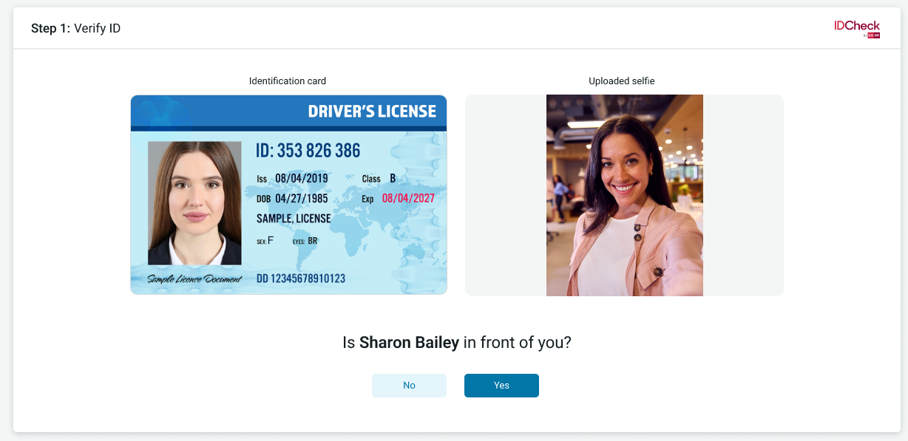
Shared Branch: Teller Workflow
Velera does not collect any biometric information

Slide 15
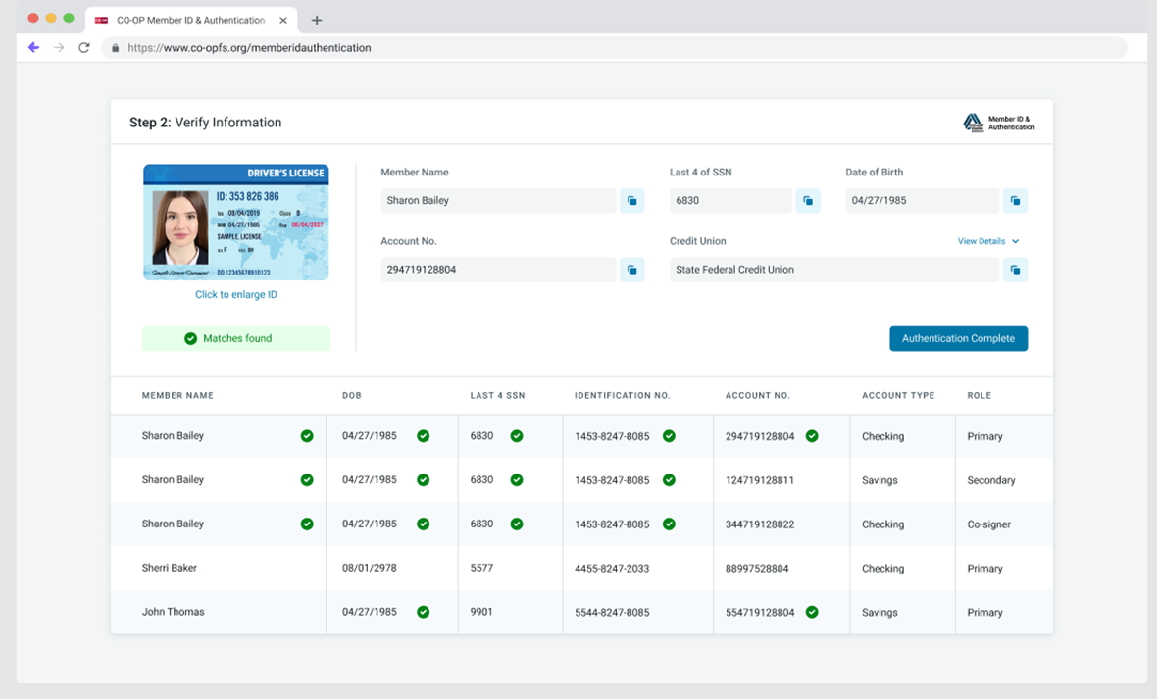

Shared Branch: Teller Workflow
Velera does not collect any biometric information

Slide 16
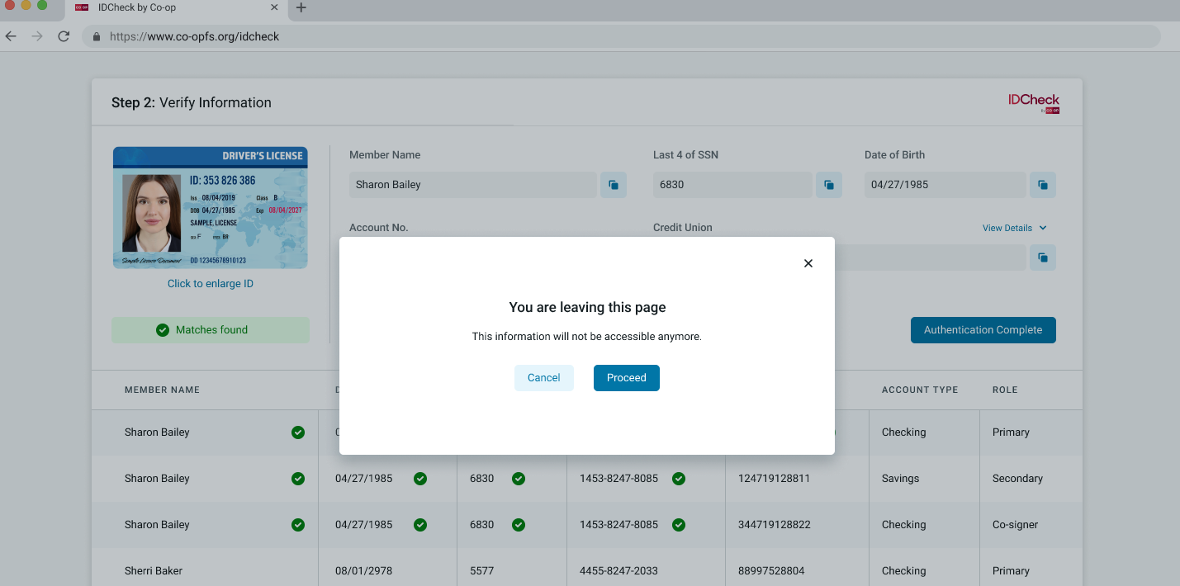
Shared Branch: Teller Workflow
Velera does not collect any biometric information

Slide 17
Shared Branch: Teller Workflow
Velera does not collect any biometric information

Slide 18




IDCheck Reporting Details
Date/ time
Member name/account
Employee name
ID details
Verification response details
Velera does not collect any biometric information

Slide 19
This presentation and the materials included, such as pricing information, product/services information or other data is confidential and intended solely for the designated recipient or client. Any other use or sharing of this presentation and related material is prohibited. Information presented herein may be updated or changed at any time by Velera.

Slide 20


